Slide 1

Juan David Serna Valderrama
Hands-On Recommendation Systems
January 2021

Slide 2
What this presentation covers?
What's on the agenda?
— Getting Started with Recommender Systems
— Manipulating Data with the Pandas Library
— Building an IMDB Top 250 Clone with Pandas
— Building Content-Based Recommenders
— Getting Started with Data Mining Techniques
— Building Collaborative Filters
— Hybrid Recommenders
Hands-On Recommendation Systems| January 2021

Slide 3

Getting Started with Recommender Systems
Introduces the recommendation problem and the models popularly used to solve it.
Hands-On Recommendation Systems| January 2021

Slide 4



Introduction
Almost everything we buy or consume today is influenced by some form of recommendation.
When you log on to Netflix or Amazon Prime, for example, you will see a list of movies and television shows the service thinks you will like based on your past
watching (and rating) history. Facebook suggests people it thinks you may
know and would probably like to add.
Amazon recommends items to you as you browse for a particular product. It shows you similar products from a competing source and suggests auxiliary items frequently bought together with the product.
Hands-On Recommendation Systems| January 2021

Slide 5
Key questions
What is a recommender system?
What can it do and not do?
The different types of recommender systems?
Hands-On Recommendation Systems| January 2021

Slide 6
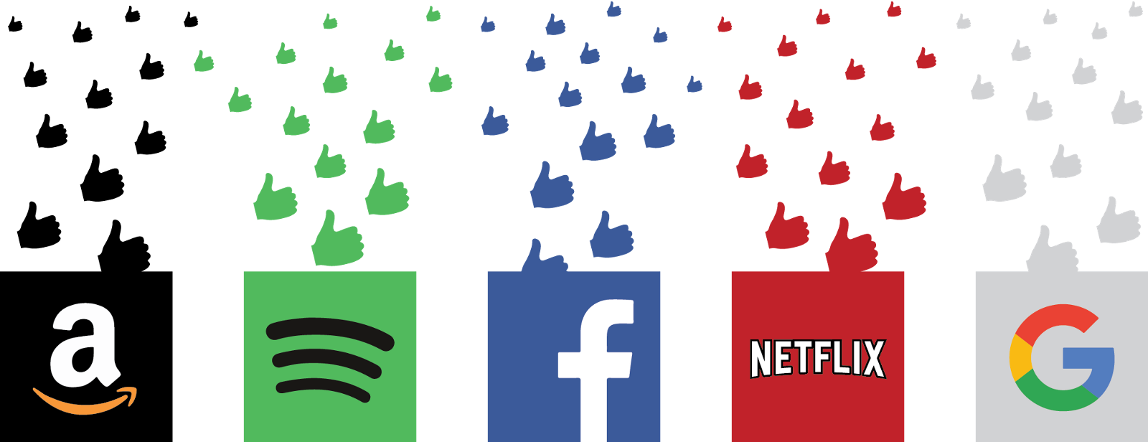
What is a recommender system?
Recommender systems are pretty self-explanatory; as the name suggests, they are systems or techniques that recommend or suggest a particular product, service, or entity. However, these systems can be classified into the following two categories, based on their approach to providing recommendations.
Hands-On Recommendation Systems| January 2021

Slide 7
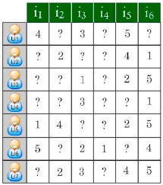
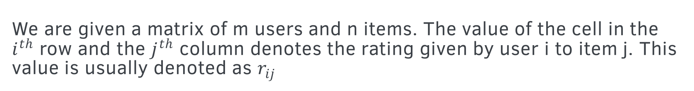
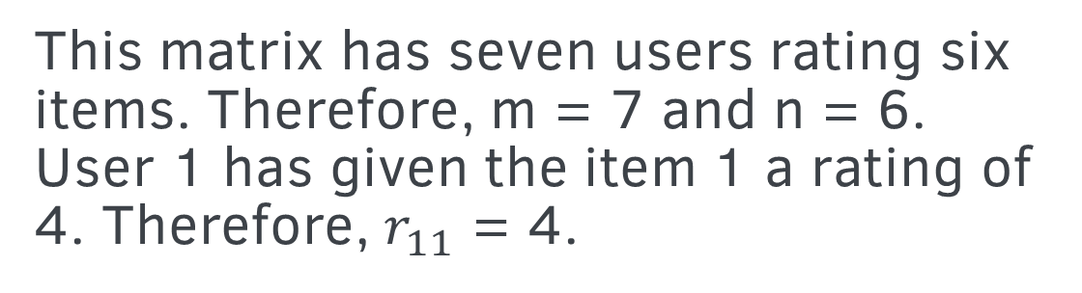
What can it do and not do?
Prediction Problem
We are given a matrix of m users and n items. The value of the cell in the $i^{th}$ row and the $j^{th}$ column denotes the rating given by user i to item j. This value is usually denoted as $r_{ij}$
This matrix has seven users rating six items. Therefore, m = 7 and n = 6.
User 1 has given the item 1 a rating of 4. Therefore, $r_{11}$ = 4.
Hands-On Recommendation Systems| January 2021

Slide 8
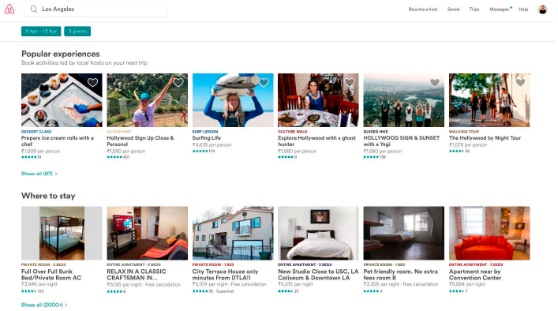
Ranking Problem
Imagine you are Airbnb, much like the preceding example. Your user has input the specific things they are looking for in their host and the space (such as their location, and budget). You want to display the top 10 results that satisfy those aforementioned conditions.
If we are able to predict missing values, we can extract the top values and display them as our results.
Hands-On Recommendation Systems| January 2021

Slide 9
The different types of recommender systems?
Collaborative filtering
Collaborative filters are one of the most popular recommender models used in the industry and have found huge success for companies such as Amazon. Collaborative filtering can be broadly classified into two types.
Collaborative filtering
User-based filtering
Item-based filtering
Hands-On Recommendation Systems| January 2021

Slide 10
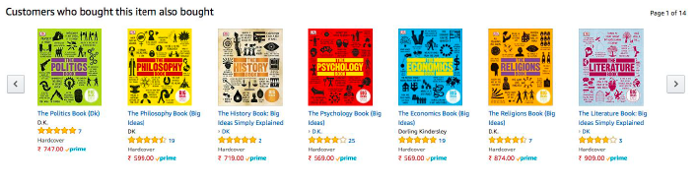
User-based filtering
The main idea behind user-based filtering is that if we are able to find users that have bought and liked similar items in the past, they are more likely to buy similar items in the future too. Therefore, these models recommend items to a user that similar users have also liked.
Imagine that Alice and Bob mostly like and dislike the same video games.
Now, imagine that a new video game has been launched on the market. Let's
say Alice bought the game and loved it.
Hands-On Recommendation Systems| January 2021

Slide 11
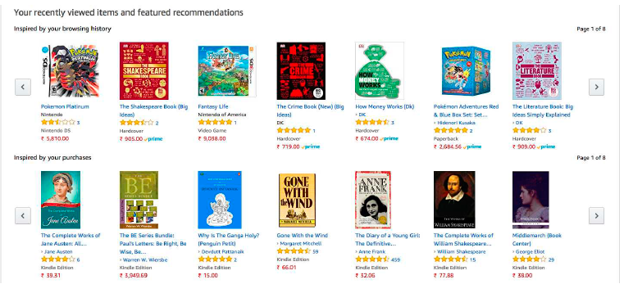
Item-based filtering
If a group of people have rated two items similarly, then the two items must be similar. Therefore, if a person likes one particular item, they're likely to be interested in the other item too. This is the principle on which item-based filtering works.
Again, Amazon makes good use of this model by recommending products to you based on your browsing and purchase history.
Hands-On Recommendation Systems| January 2021

Slide 12
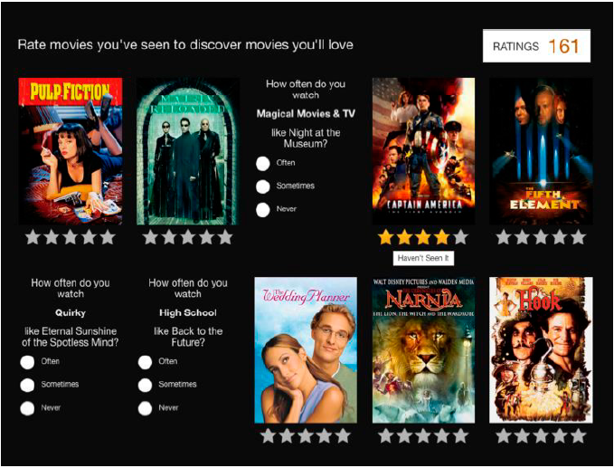
Content-based systems
Unlike collaborative filters, content-based systems do not require data
relating to past activity. Instead, they provide recommendations based on a user profile and metadata it has on particular items.
What Netflix does instead is ask you
to rate a few movies that you have watched before. Based on this
information and the metadata it already has on movies, it creates a watchlist for you.
Hands-On Recommendation Systems| January 2021

Slide 13
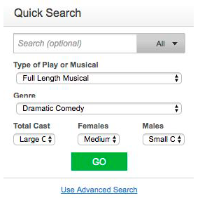
Knowledge-based recommenders
Knowledge-based recommenders are used for items that are very rarely
bought. It is simply impossible to recommend such items based on past
purchasing activity or by building a user profile. Take real estate, for
instance. Real estate is usually a once-in-a-lifetime purchase for a family.
Knowledge-based recommenders also suffer from the problem of low
novelty, however. Users know full-well what to expect from the results and
are seldom taken by surprise.
Hands-On Recommendation Systems| January 2021

Slide 14
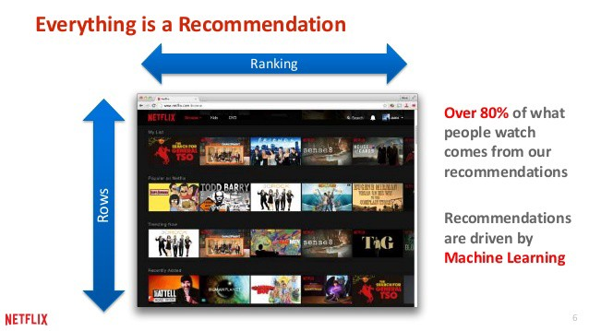
Hybrid recommenders
As the name suggests, hybrid recommenders are robust systems that
combine various types of recommender models, including the ones we've
already explained. As we've seen in previous sections, each model has its
own set of advantages and disadvantages.
Let's consider the Netflix example again. When you sign in for the first
time, Netflix overcomes the cold start problem of collaborative filters by
using a content-based recommender, and, as you gradually start watching
and rating movies, it brings its collaborative filtering mechanism into play.
This is far more successful, so most practical recommender systems are
hybrid in nature.
Hands-On Recommendation Systems| January 2021

Slide 15

Summary
We gained an overview of the world of recommender systems. We saw two approaches to solving the recommendation problem; namely, prediction and ranking. Finally, we examined the various types of recommender systems and discussed their advantages and disadvantages.
In the next chapter, we will learn to process data with pandas, the data analysis library of choice in Python. This, in turn, will aid us in building the various recommender systems we've introduced.
Hands-On Recommendation Systems| January 2021

Slide 16
Steps for Machine Learning
— Import the Data
— Clean the Data
— Split the Data into Training/Test Sets
— Create a model
— Make predictions
— Evaluate and improve
Hands-On Recommendation Systems| January 2021

Slide 17

Manipulating Data with the Pandas Library
Illustrates various data wrangling techniques using the Pandas library.
Hands-On Recommendation Systems| January 2021

Slide 18
Summary
We gained an understanding of the limitations of using vanilla Python and its built-in data structures. We acquainted ourselves with the Pandas library and learned how it overcomes the aforementioned difficulties by giving us access to extremely powerful and easy-to-use data structures. We then explored the two main data structures, Series and DataFrame, by analyzing our movies-metadata dataset.
In the next chapter, we will use our newfound skills to build an IMDB Top 250 Clone and its variant, a type of knowledge-based recommender.
Hands-On Recommendation Systems| January 2021

Slide 19

Building an IMDB Top 250 Clone with Pandas
Walks through the process of building a top movies chart and a knowledge-based
recommender that explicitly takes in user preferences.
Hands-On Recommendation Systems| January 2021

Slide 20
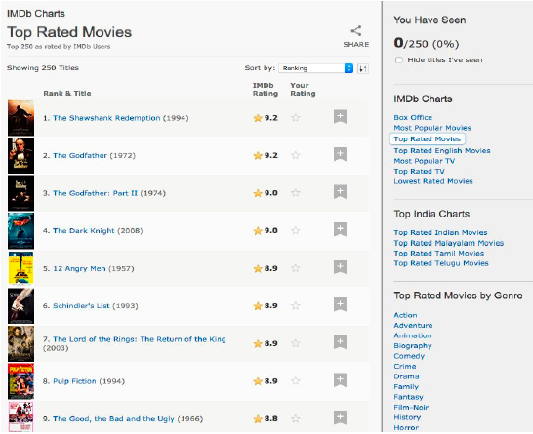
Internet Movie Database (IMDB)
The Internet Movie Database (IMDB) maintains a chart called the IMDB
Top 250, which is a ranking of the top 250 movies according to a certain
scoring metric. All the movies in this list are non-documentary, theatrical
releases with a runtime of at least 45 minutes and over 250,000 ratings
This chart can be considered the simplest of recommenders. It doesn't take into consideration the tastes of a particular user, nor does it try to deduce similarities between different movies.
Hands-On Recommendation Systems| January 2021

Slide 21
The steps are as follows:
1. Choose a metric (or score) to rate the movies on
2. Decide on the prerequisites for the movie to be featured on the chart
3. Calculate the score for every movie that satisfies the conditions
4. Output the list of movies in decreasing order of their scores
Movie rated 9 by 100,000 users will be placed below a movie rated 9.5 by 100 users. This is not desirable as it is highly likely that a movie watched and rated only by 100 people caters to a very specific niche and may not appeal as much to the average person as the former.
Therefore, what we need is a metric that can, to an extent, take into account the movie rating and the number of votes it has garnered (a proxy for popularity). This would give a greater preference to a blockbuster movie rated 8 by 100,000 users over an art house movie rated 9 by 100 users.
Hands-On Recommendation Systems| January 2021

Slide 22
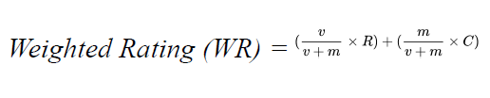
Movie rating
As the title of this chapter states, we are building an IMDB top 250
clone. Therefore, we shall use IMDB's weighted rating formula as our
metric. Mathematically, it can be represented as follows:
v is the number of votes garnered by the movie.
m is the minimum number of votes required for the movie to be in the
chart (the prerequisite).
R is the mean rating of the movie.
C is the mean rating of all the movies in the dataset.
Hands-On Recommendation Systems| January 2021

Slide 23
The knowledge-based recommender
We are going to go ahead and build a knowledge-based
recommender on top of our IMDB Top 250 clone. This will be a simple
function that will perform.
1. Ask the user for the genres of movies he/she is looking for
2. Ask the user for the duration
3. Ask the user for the timeline of the movies recommended
4. Using the information collected, recommend movies to the user that
have a high weighted rating (according to the IMDB formula) and that
satisfy the preceding conditions
Hands-On Recommendation Systems| January 2021

Slide 24
Summary
We built a simple recommender, which was a clone of the IMDB Top 250 chart. We then proceeded to build an improved knowledge-based recommender, which asked the user for their preferred genres, duration, and time. In the process of building these models, we also learned to perform some advanced data wrangling with the Pandas library.
In the next chapter, we will use more advanced features and techniques to build a content-based recommender. This model will be able to detect similar movies based on their plots and recommend movies by identifying similarities in genre, cast, crew, plot, and so on.
Hands-On Recommendation Systems| January 2021

Slide 25

Building Content-Based Recommenders
Describes the process of building models that make use of movie plot lines and other metadata to offer recommendations.
Hands-On Recommendation Systems| January 2021

Slide 26
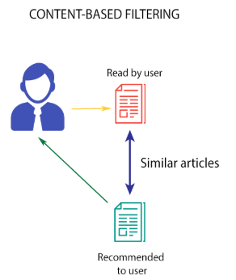
Example
Imagine that Alice likes the movies The Dark Knight, Iron Man, and Man
of Steel. It is pretty evident that Alice has a taste for superhero movies.
However, our models from the previous chapter would not be able to
capture this detail.
It is also possible that two movies have the same genre, timeline, and
duration characteristics but differ hugely in their audience. Consider
The Hangover and Forgetting Sarah Marshall, for example.
Both these movies were released in the first decade of the 21st century, both lasted around two hours, and both were comedies. However, the kind of audience that enjoyed these movies was very different.
Hands-On Recommendation Systems| January 2021

Slide 27
two types of content-based recommender
Plot description-based recommender: This model compares the
descriptions and taglines of different movies, and provides
recommendations that have the most similar plot descriptions.
Metadata-based recommender: This model takes a host of features,
such as genres, keywords, cast, and crew, into consideration and
provides recommendations that are the most similar with respect to the aforementioned features.
Hands-On Recommendation Systems| January 2021

Slide 28
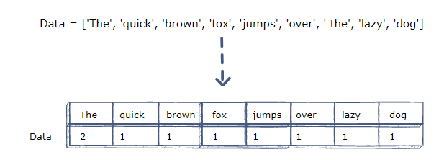
CountVectorizer
CountVectorizer is the simplest type of vectorizer and is best explained with the help of an example. Imagine that we have three documents, A, B, and C, which are as follows:
A: The sun is a star.
B: My love is like a red, red rose
C: Mary had a little lamb
The, sun, is, a, star, my, love, like, red, rose, mary, had, little, lamb.
Consequently, the size of the vocabulary is 14.
V: like, little, lamb, love, mary, red, rose, sun, star.
A: (0, 0, 0, 0, 0, 0, 0, 1, 1)
B: (1, 0, 0, 1, 0, 2, 1, 0, 0)
C: (0, 1, 1, 0, 1, 0, 0, 0, 0)
Hands-On Recommendation Systems| January 2021

Slide 29
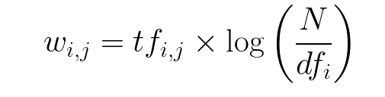
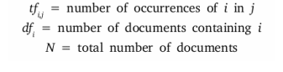
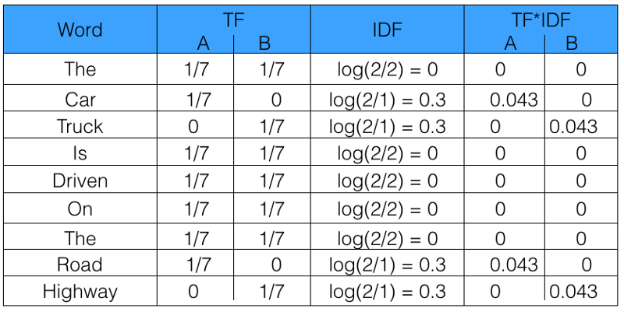
TF-IDF Vectorizer
takes the aforementioned point into consideration and assigns
weights to each word according to the following formula. For every word
i in document j, the following applies:
Let’s take an example to get a clearer understanding.
Sentence 1 : The car is driven on the road.
Sentence 2: The truck is driven on the highway.
Hands-On Recommendation Systems| January 2021

Slide 30
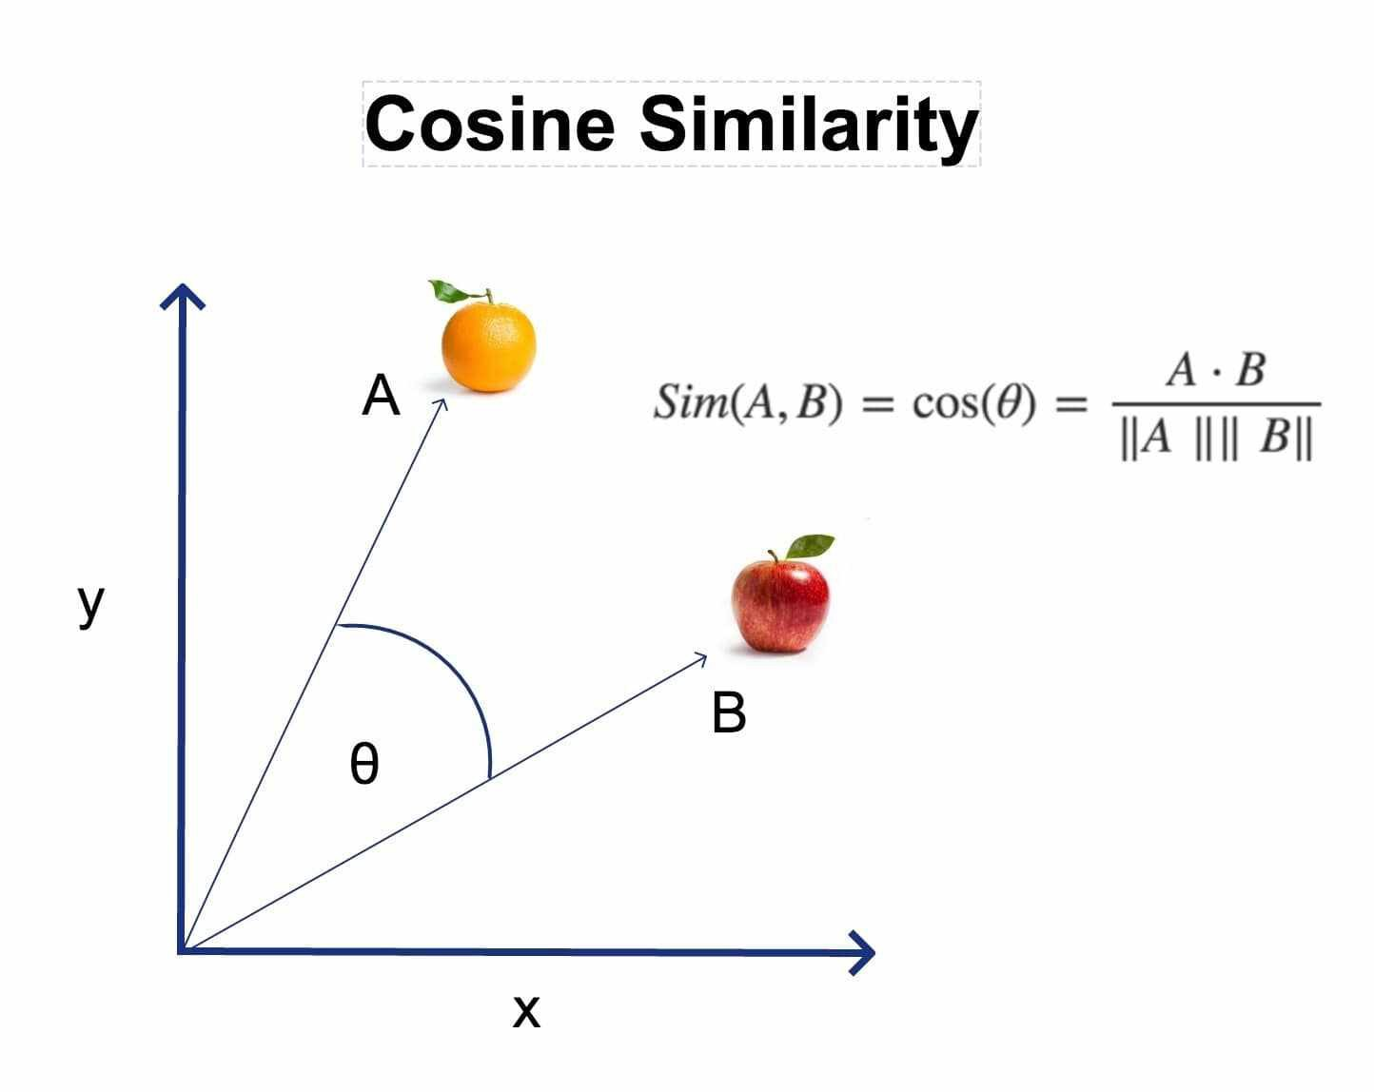
The cosine similarity score
The cosine score is extremely robust and easy to calculate (especially when used in conjunction with TFIDFVectorizer).
The cosine similarity score between two documents, x and y, is as follows:
The cosine score can take any value between -1 and 1. The higher the
cosine score, the more similar the documents are to each other.
https://medium.com/analytics-vidhya/how-recommendation-systems-work-75efdd562be
Hands-On Recommendation Systems| January 2021

Slide 31
Plot description-based recommender
These are the steps we are going to perform in building this model:
1. Obtain the data required to build the model
2. Create TF-IDF vectors for the plot description (or overview) of every
movie
3. Compute the pairwise cosine similarity score of every movie
4. Write the recommender function that takes in a movie title as an
argument and outputs movies most similar to it based on the plot
Hands-On Recommendation Systems| January 2021

Slide 32
Summary
We first learned about document vectors and gained a brief introduction to the cosine similarity score. Next, we built a recommender that identified movies with similar plot descriptions. We then proceeded to build a more advanced model that leveraged the power of other metadata, such as genres, keywords, and credits. Finally, we discussed a few methods by which we could improve our existing system.
With this, we formally come to an end of our tour of content-based recommendation system. In the next chapters, we will cover what is arguably the most popular recommendation model in the industry today: collaborative filtering.
Hands-On Recommendation Systems| January 2021

Slide 33
Getting Started with Data Mining Techniques
Covers various similarity scores, machine learning techniques, and evaluation metrics used to build and gauge performances of collaborative recommender models.
Hands-On Recommendation Systems| January 2021

Slide 34
Topics
Similarity measures: Given two items, how do we mathematically quantify how different or similar they are to each other? Similarity measures help us in answering this question. We have already made use of a similarity measure (the cosine score) while building our content recommendation engine. In this chapter, we will be looking at a few other popular similarity scores.
Dimensionality reduction: When building collaborative filters, we are
usually dealing with millions of users rating millions of items. In such
cases, our user and item vectors are going to be of a dimension in the
order of millions.
Hands-On Recommendation Systems| January 2021

Slide 35
Topics
Supervised learning: Supervised learning is a class of machine
learning algorithm that makes use of label data to infer a mapping
function that can then be used to predict the label (or class) of
unlabeled data.
Clustering: Clustering is a type of unsupervised learning where the
algorithm tries to divide all the data points into a certain number of
clusters. Therefore, without the use of a label dataset, the clustering
algorithm is able to assign classes to all the unlabel points.
Evaluation methods and metrics: We will take a look at a few
evaluation metrics that are used to gauge the performance of these
algorithms. The metrics include accuracy, precision, and recall.
Hands-On Recommendation Systems| January 2021

Slide 36
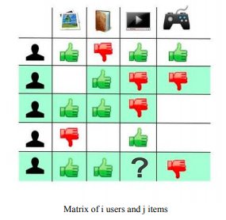
Problem statement
Collaborative filtering algorithms try to solve the prediction problem. In other words, we are given a matrix of i users and j items. The value in the ith row and the jth column (denoted by rij) denotes the rating given by user i to item j:
Our job is to complete this matrix. In other words, we need to predict all the cells in the matrix that we have no data for.
Hands-On Recommendation Systems| January 2021

Slide 37
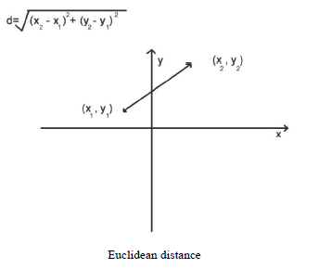
Euclidean distance
The Euclidean distance can be defined as the length of the line segment
joining the two data points plotted on an n-dimensional Cartesian plane.
v1: (q1, q2,...., qn)
v2: (r1, r2,....., rn)
Hands-On Recommendation Systems| January 2021

Slide 38
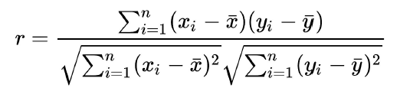

Pearson correlation
The Pearson correlation is a score between -1 and 1, where -1 indicates total negative correlation (as in the case with Alice and Eve) and 1 indicates total positive correlation (as in the case with Alice and Bob), whereas 0 indicates that the two entities are in no way correlated with each other (or are independent ofeach other).
Here $\overline{i}$, denotes the mean of all the elements in vector $i.$
Hands-On Recommendation Systems| January 2021

Slide 39
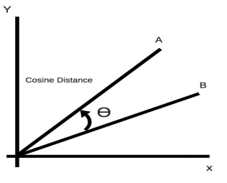
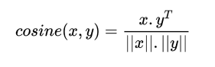
Cosine similarity
The cosine similarity score computes the cosine of the angle between two
vectors in an n-dimensional space. When the cosine score is 1 (or angle is
0), the vectors are exactly similar. On the other hand, a cosine score of -1
(or angle 180 degrees) denotes that the two vectors are exactly dissimilar to each other.
Hands-On Recommendation Systems| January 2021

Slide 40
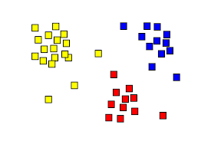
Clustering
One of the main ideas behind collaborative filtering is that if user A has the same opinion of a product as user B, then A is also more likely to have the same opinion as B on another product than that of a randomly chosen user.
The job of a clustering algorithm is to assign classes to every point on this plane.
Hands-On Recommendation Systems| January 2021

Slide 41
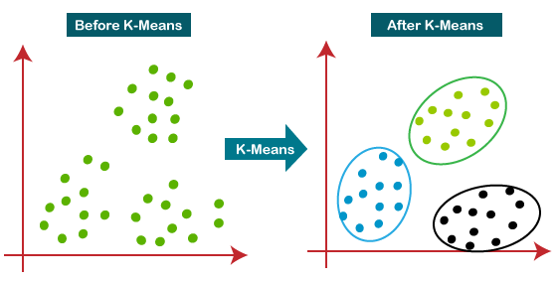
k-means clustering
The k-means algorithm is one of the simplest yet most popular machine
learning algorithms. It takes in the data points and the number of clusters
(k) as input.
One of the most important steps while using the k-means algorithm is determining the number of clusters.
Hands-On Recommendation Systems| January 2021

Slide 42
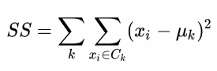
Choosing k
The Elbow method computes the sum of squares for each value of k and
chooses the elbow point of the sum-of-squares v/s K plot as the best value for k. The elbow point is defined as the value of k at which the sum-ofsquares value for every subsequent k starts decreasing much more slowly.
The sum of squares value is defined as the sum of the distances of each data point to the centroid of the cluster to which it was assigned. Mathematically, it is expressed as follows:
Hands-On Recommendation Systems| January 2021

Slide 43
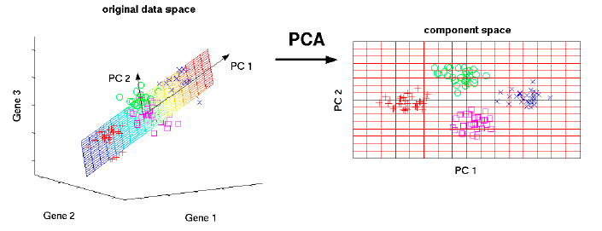
Dimensionality reduction (PCA)
Feature selection: This method involves identifying the features that
have the least predictive power and dropping them altogether.
Therefore, feature selection involves identifying a subset of features
that is most important for that particular use case.
Feature extraction: Feature extraction takes in m-dimensional data
and transforms it into an n-dimensional output space (usually where m
>> n), while retaining most of the information. However, in doing so,
it creates new features that have no inherent meaning.
Hands-On Recommendation Systems| January 2021

Slide 44
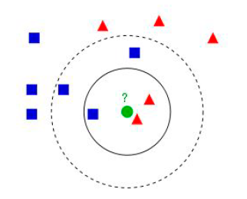
k-nearest neighbors
k-nearest neighbors (k-NN) is perhaps the simplest machine learning
algorithm. In the case of classification, it assigns a class to a particular data point by a majority vote of its k nearest neighbors. In other words, the data point is assigned the class that is the most common among its k-nearest neighbors.
Consider a dataset that has binary classes (represented as the blue squares and the red triangles). k-NN now plots this into n-dimensional space (in this case, two
dimensions).
It is often a good practice to test different values of k and assess its performance with your cross-validation and test datasets.
Hands-On Recommendation Systems| January 2021

Slide 45
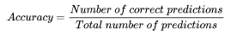
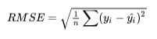
Binary classification metrics
Accuracy: Accuracy is the most widely used metric to gauge the performance of a
classification model. It is the ratio of the number of correct predictions to
the total number of predictions made by the model:
Root mean square error: The Root Mean Square Error (or RMSE) is a metric widely used to gauge the performance of regressors. Mathematically, it is represented as follows:
Hands-On Recommendation Systems| January 2021

Slide 46
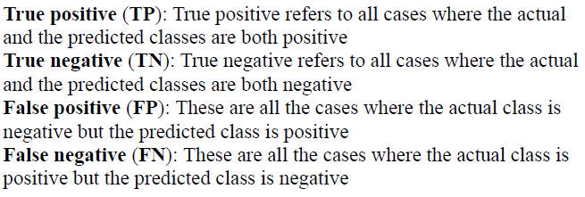
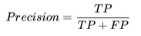
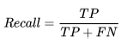
Evaluation metrics
The precision is the ratio of the number of positive cases that were correct to all the cases that were identified as positive. Mathematically, it looks like this:
The recall is the ratio of the number of positive cases that were identified to the all positive cases present in the dataset:
Hands-On Recommendation Systems| January 2021

Slide 47
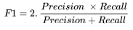
Evaluation metrics
The F1 score is a metric that conveys the balance between precision and recall. It is the harmonic mean of the precision and recall. An F1 score of 1implies perfect precision and recall, whereas a score of 0 implies precision and recall are not possible:
Hands-On Recommendation Systems| January 2021

Slide 48
Summary
We have covered a lot of topics that will help us to build powerful collaborative filters. We took a look at clustering, a form of unsupervised learning algorithm that could help us to segregate users into well defined clusters. Next, we went through a few dimensionality reduction techniques to overcome the curse of dimensionality and improve the performance of our learning algorithms.
The subsequent section dealt with supervised learning algorithms, and finally we ended the chapter with a brief overview of various evaluation metrics.
In case you're interested, a more detailed treatment of the topics presented in this chapter is available in an
excellent book entitled Python Machine Learning by Sebastian Thrun.
Hands-On Recommendation Systems| January 2021

Slide 49
Building Collaborative Filters
Walks through the building of various collaborative filters that leverage user rating data to offer recommendations.
Hands-On Recommendation Systems| January 2021

Slide 50
Summary
We built various kinds of user-based collaborative filters and, by extension, learned to build item-based collaborative filters as well.
We then shifted our focus to model-based approaches that rely on machine learning algorithms to churn out predictions. We were introduced to the surprise library and used it to implement a clustering model based on
kNN. We then took a look at an approach to using supervised learning algorithms to predict the missing values in the ratings matrix. Finally, we gained a layman's understanding of the singular-value decomposition
algorithm and implemented it using surprise.
All the recommenders we've built so far reside only inside our Jupyter Notebooks. In the next chapter, we will learn how to deploy our models to the web, where they can be used by anyone on the internet.
Hands-On Recommendation Systems| January 2021

Slide 51

Hybrid Recommenders
Outlines various kinds of hybrid recommenders used in practice and walks you through the process of building a model that incorporates both content and collaborative-based filtering.
Hands-On Recommendation Systems| January 2021

Slide 52
Summary
We briefly discussed the various kinds of hybrid recommender used in the industry today and built a model that incorporated collaborative filtering into a content-based engine to offer personalized recommendations to a user, while keeping the current movie being watched in mind.
Hands-On Recommendation Systems| January 2021

Slide 53
Summary
1
2
3
We were introduced to the world of recommender systems. We defined the recommendation problem mathematically and discussed the various types of recommendation engines that exist, as well as their advantages and disadvantages.
With our newly found data wrangling techniques, we proceeded to
build an IMDB Top 250 clone. We then improved on this model to
build a knowledge-based recommender that took into account the recommended movies' genre, duration, and year of release.
We then learned to perform data wrangling with the pandas library and familiarized ourselves with two of pandas, most powerful data structures: the series and the DataFrame.
Hands-On Recommendation Systems| January 2021

Slide 54
Summary
4
5
6
We learned how to build content-based recommenders using plot lines and subsequently more sophisticated metadata, such as the genre, cast, crew, and keywords. In the process, we familiarized ourselves with vectorizers and the cosine similarity metric.
Then proceeded to study clustering, with an emphasis on k-means clustering techniques. This was followed by discussions on
dimensionality reduction (with an emphasis on PCA) and the various
supervised learning techniques.
In the chapter on data mining, we were introduced to the various techniques used in building and improving recommendation systems.
We learned about similarity metrics other than the cosine score.
Hands-On Recommendation Systems| January 2021

Slide 55
Summary
7
8
10
The chapter on collaborative filtering had us experimenting with a variety of models that used rating data, and also leveraged data mining
techniques introduced in the previous chapter.
The chapter concluded with a tour of evaluation metrics that are used to gauge the performance of recommender systems.
We were also introduced
to the surprise library, which made building recommender systems a
breeze.
Hands-On Recommendation Systems| January 2021

Slide 56
Time Series
Linear Regression
Logistic Regression
Decision Trees
General projects
Lil Mix Bakery Online Ads
Random Forest
Presentations are communication tools that can be used as demonstrations, lectures, speeches, reports, and more.
Neuronal Networks
Time Series
Bijou Solutions, Inc. SEO Campaign
Clustering
Dimensionality Reduction (SVD, PCA)
It is mostly presented before an audience. It serves a variety of purposes, making presentations powerful tools for teaching.
Optimization Problems (PuLP)
Hands-On Recommendation Systems| January 2021

Slide 57
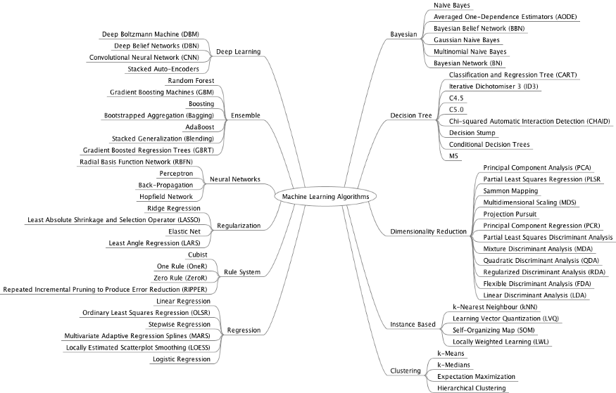
Upcoming projects

Slide 58
In-progress projects
House Prices
Wine Quality
Now that you understand classification problems, it's time to look into regression.
Here you'll predict the price of a house given its characteristics.
Another classic problem where you can explore regression and classification algorithms is the Wine Quality challenge.
Mall Customer Segmentation Data
The Walmart Challenge
Now it's time to look into Unsupervised Learning techniques, and this dataset is a great start.
Your goal here is to determine which customers are a good target for your marketing department.
Time series analysis is another big area covered by Machine Learning, and the Walmart dataset will get you started.
Here you will be predicting Walmart's weekly sales based on past data.
Hands-On Recommendation Systems| January 2021

Slide 59
Upcoming projects
Analyzing images of products on a production line to automatically classify them
Detecting tumors in brains scans
This is semantic segmentation. Where each pixel in the images is classified, typically using CNNs as well.
This is image classification, typically performed using convolutional neuronal networks (CNN)
Forecasting company’s revenue next year.
Making your app react to voice commands
This is a regression tasks, such as Linear Regression, Polynomial Regression, Regression SVM, Ramdon Forest or RNNs.
This is speech recognition, which requires processing audio samples.
Hands-On Recommendation Systems| January 2021

Slide 60
List by Louis-François Bouchard
Looking for interesting machine learning papers to read for the break or the new year? Here is a nicely curated list by
Louis-François Bouchard.
It's a great list and I do see a few papers I have read myself on the list.
List on GitHub
Hands-On Recommendation Systems| January 2021

Slide 61
Banik, R. (2018). Hands-On Recommendation Systems with Python: Start building powerful and personalized, recommendation engines with Python. Packt Publishing Ltd.
References
Dangeti, P. (2017). Statistics for machine learning. Packt Publishing Ltd.
How to Build a Recommender System, Medium https://medium.com/datadriveninvestor/how-to-built-a-recommender-system-rs-616c988d64b2
Hands-On Recommendation Systems| January 2021

Slide 62


Thanks for listening!
Hands-On Recommendation Systems| January 2021

